Slide 1
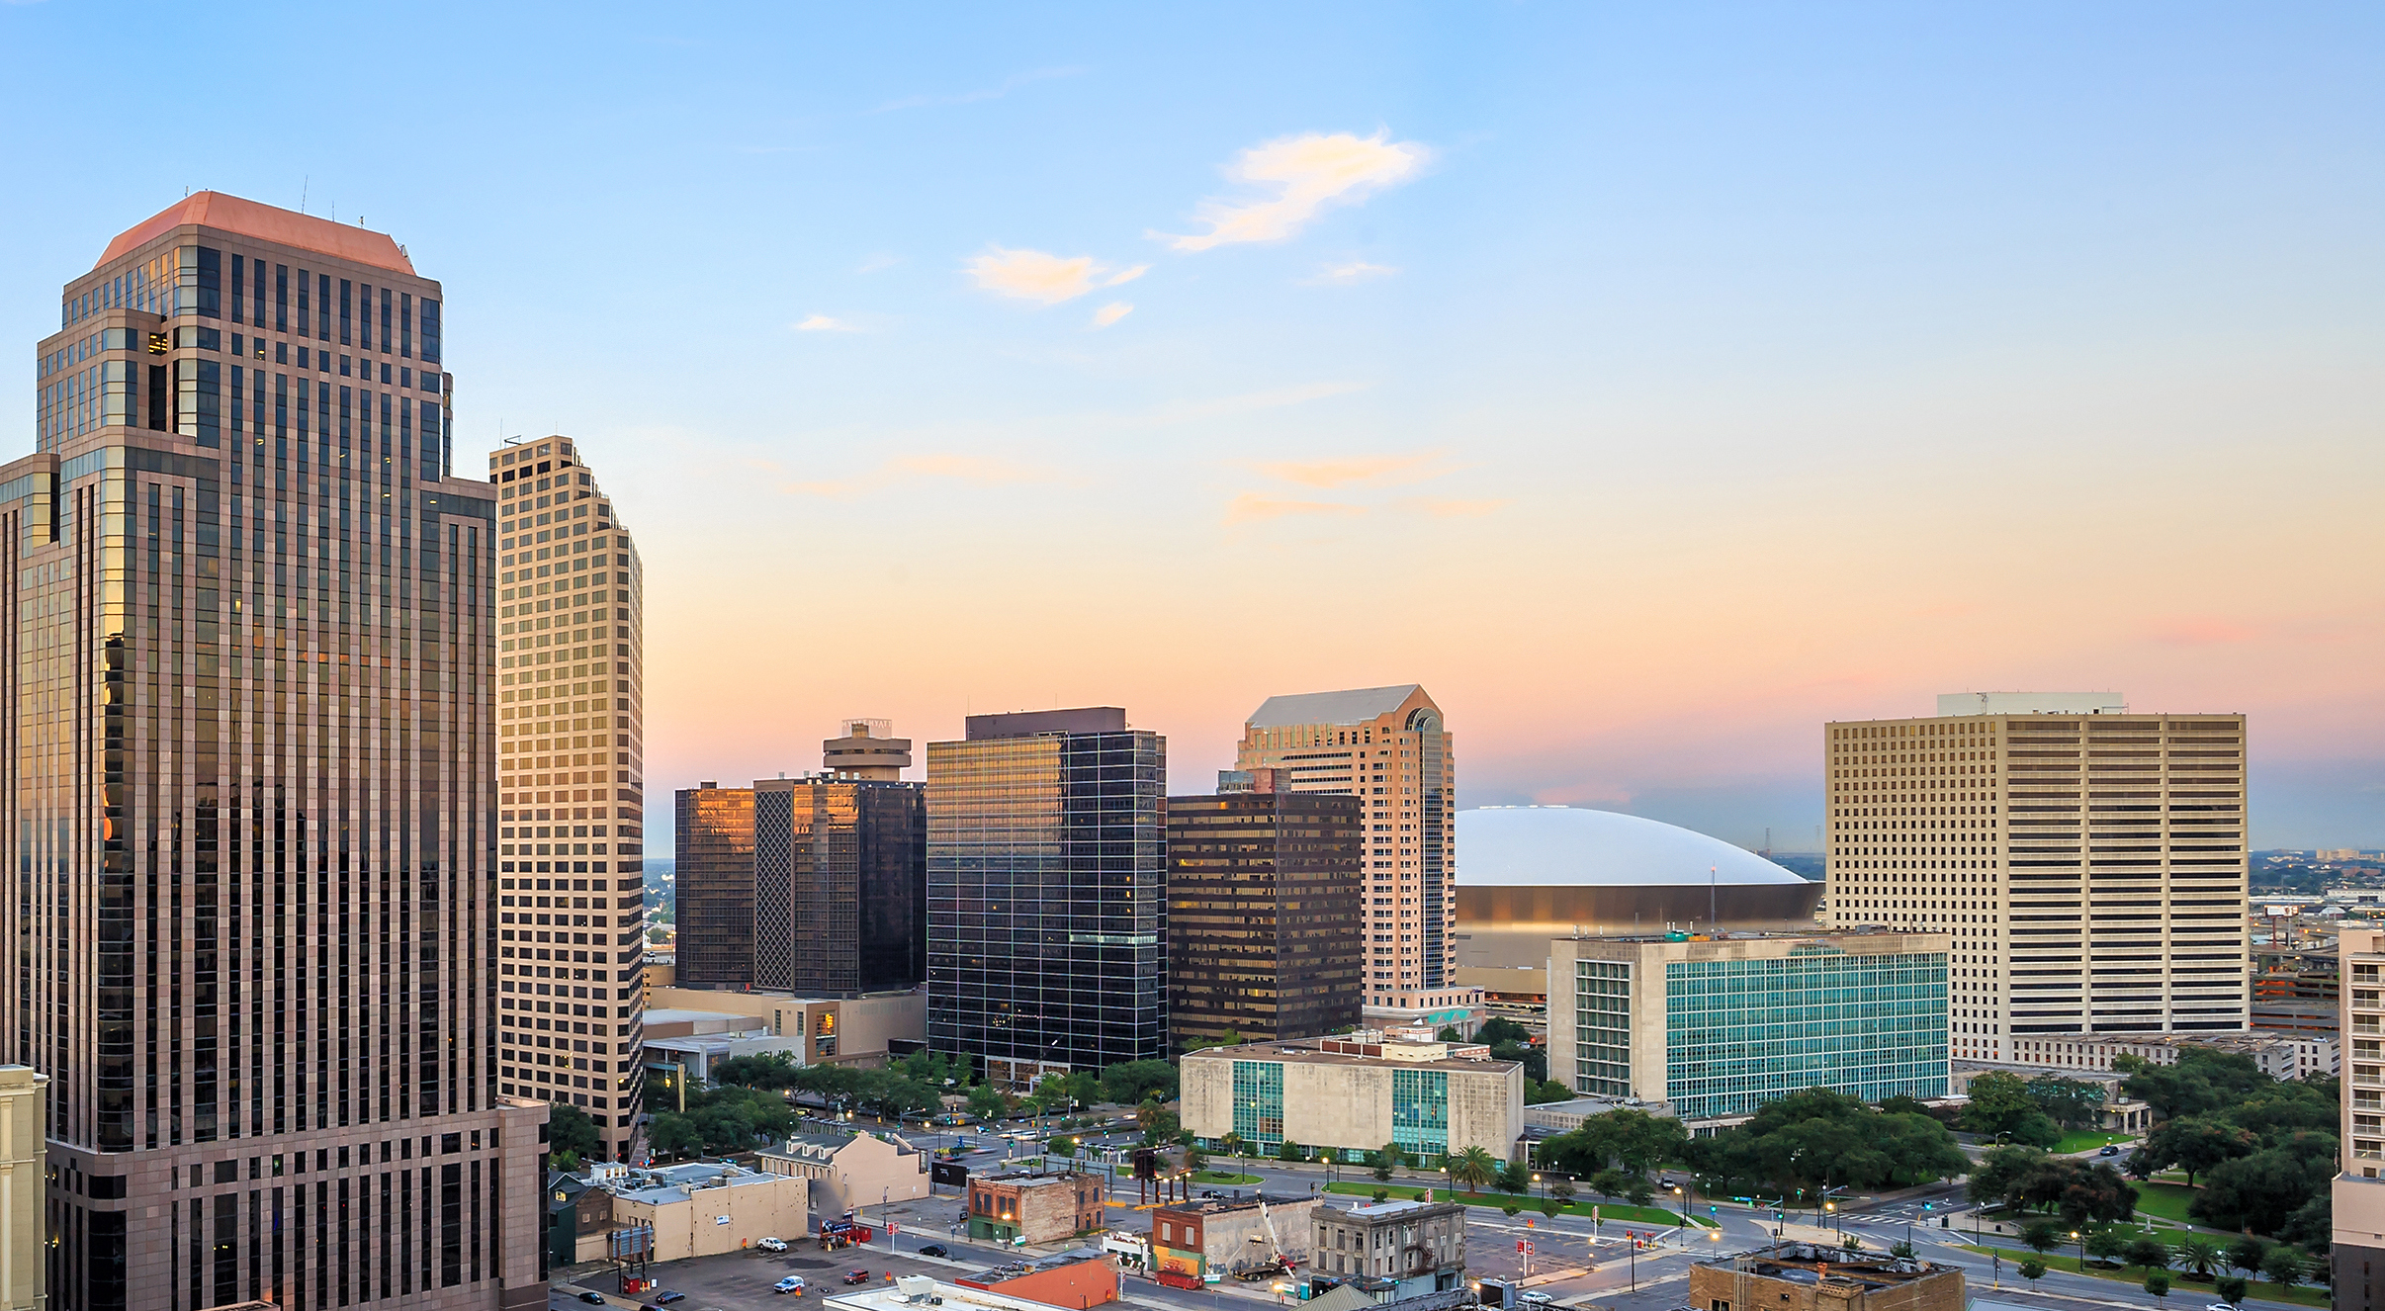


GNO, Inc. H2F + LFE Overview
Prepared for Louisiana Clean Hydrogen Task Force October 2024

Slide 2

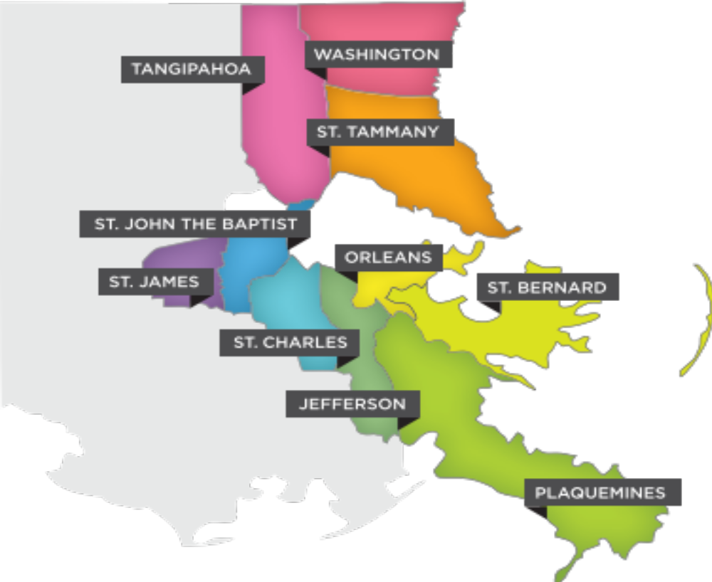
About GNO, Inc.
GNO, Inc. is the economic development organization for southeast Louisiana.
Business Development
Business Attraction
Business Growth
Business Retention
Research
v
Business Environment
Policy
Workforce
Brand Development
Ecosystem Development

Slide 3

H₂theFuture Overview
Notes:
Section Header

Slide 4



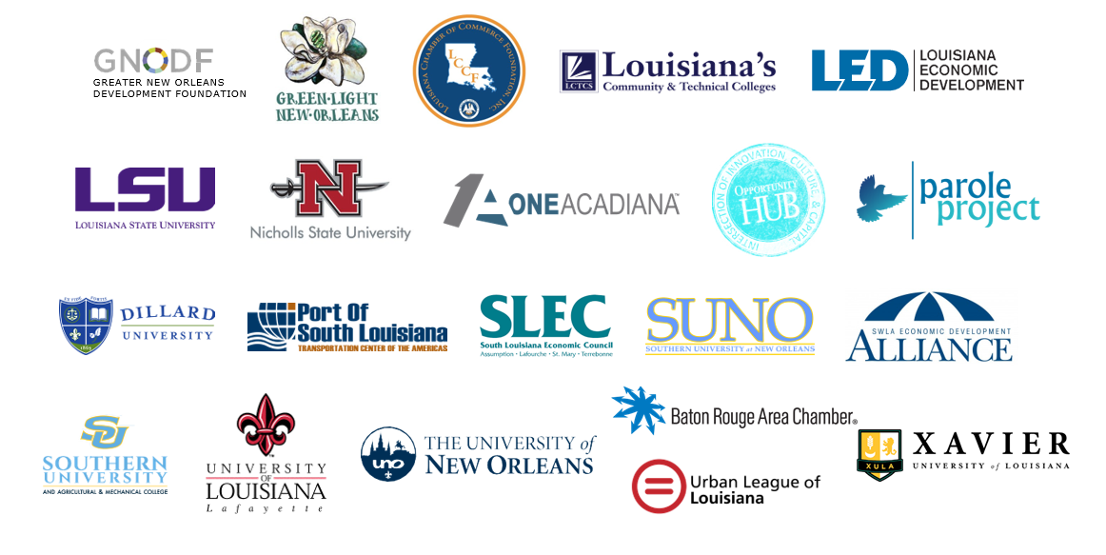
LOUISIANA FUTURE ENERGY CENTER
WHO WE ARE
H₂theFuture, led by Greater New Orleans Development Foundation, was developed with a partnership of 25 organizations across South Louisiana to decarbonize the South Louisiana industrial corridor.
H₂theFuture is an Economic Development Administration Build Back Better Regional Challenge (BBBRC) awardee and received additional support from Louisiana Economic Development.
Notes:
Who We Are

Slide 5
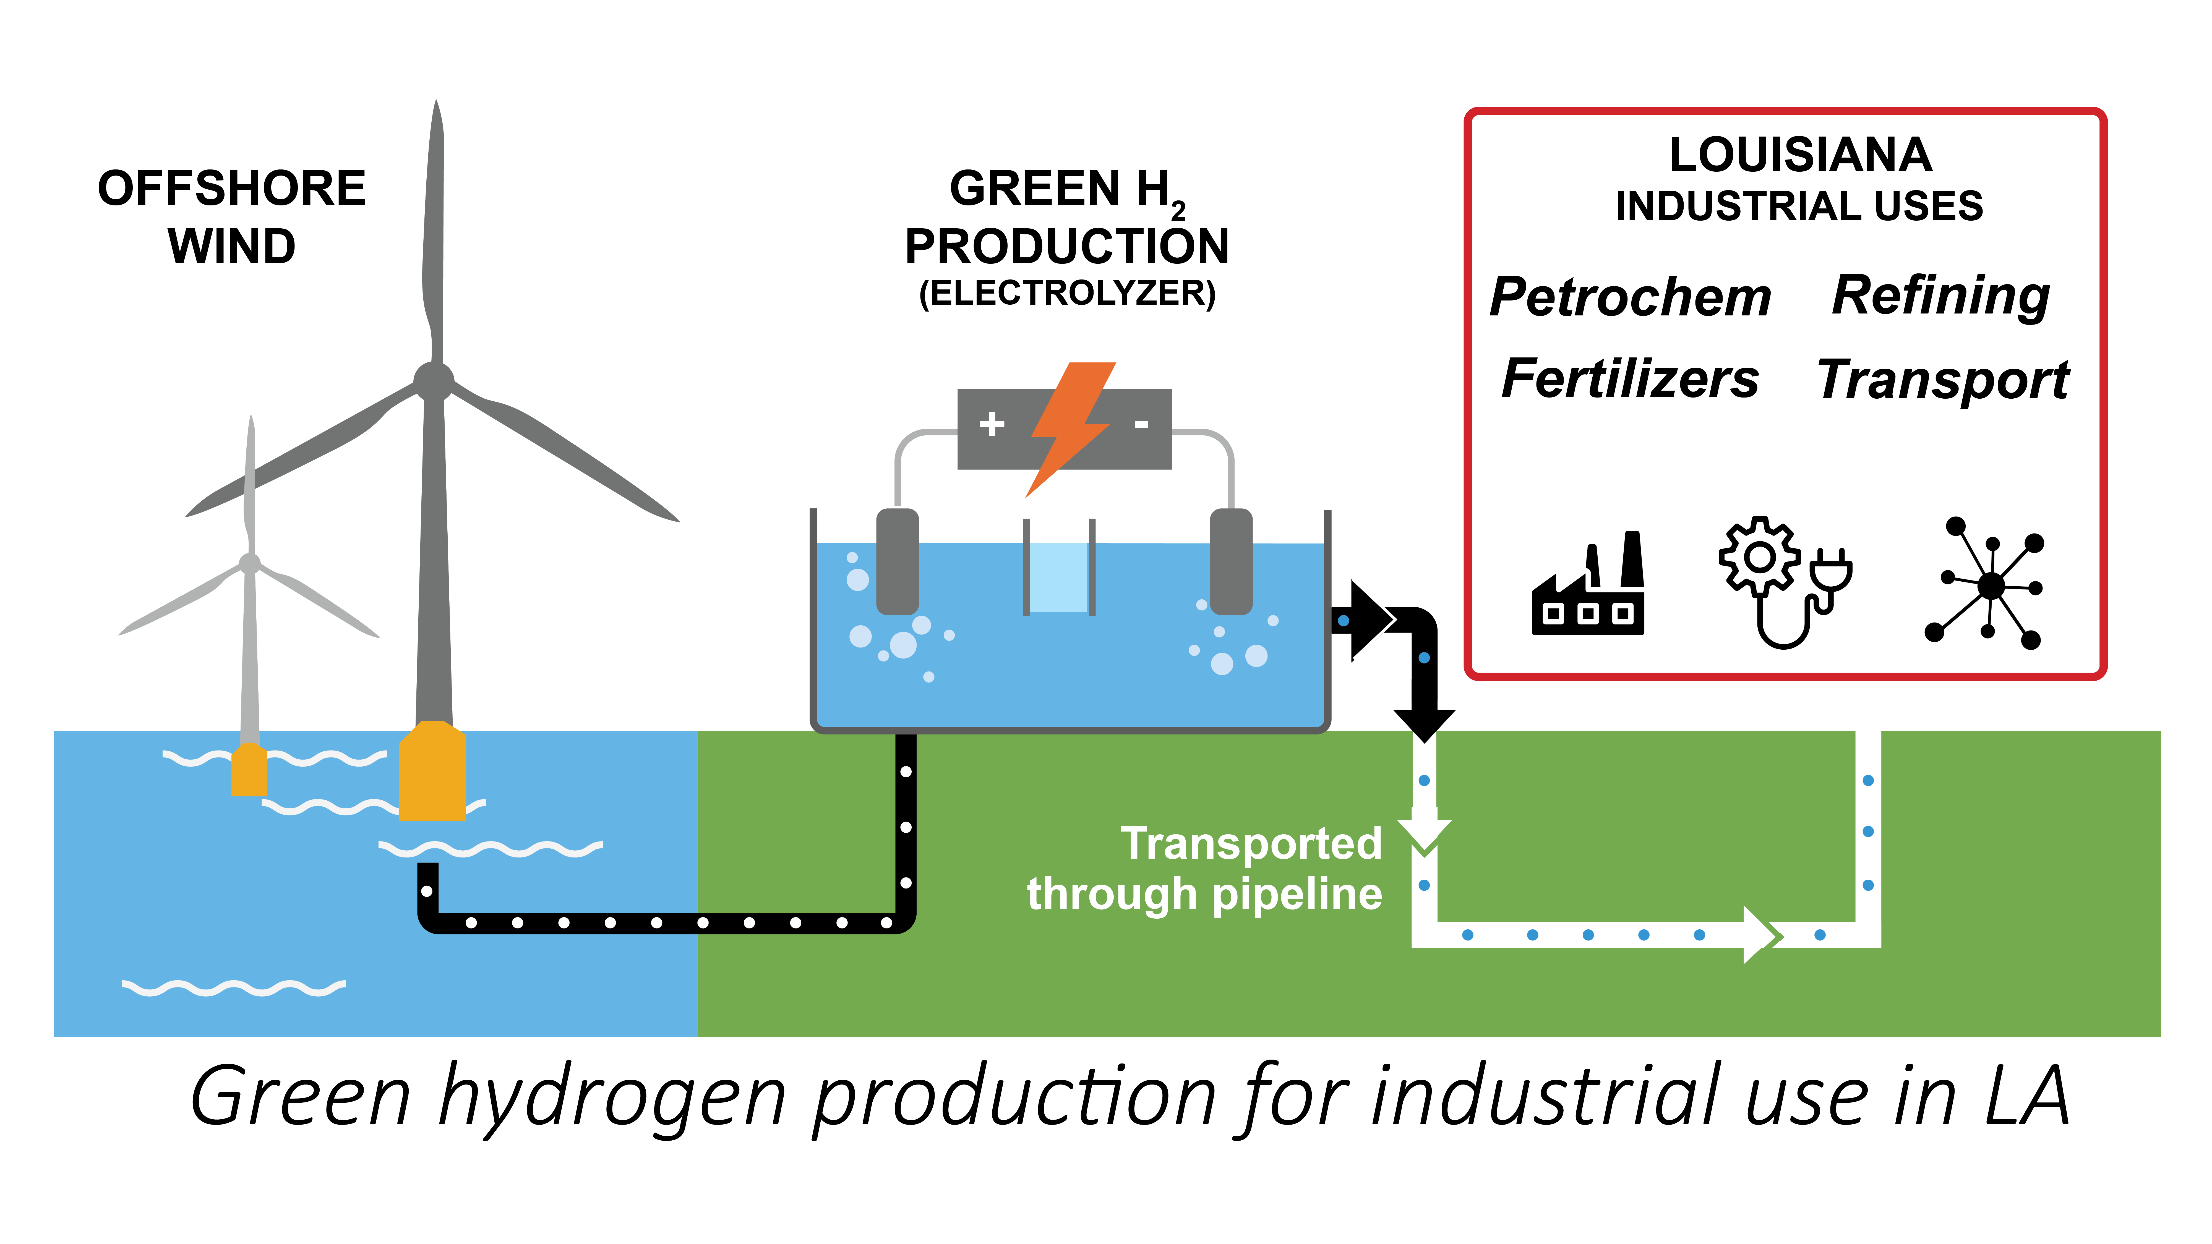
Wind to Hydrogen: P2X Offtakes
South Louisiana is well positioned to bridge to a higher-job, lower carbon future. A transition to the production and use of clean hydrogen can both decarbonize South Louisiana’s industrial corridor and can create and preserve good jobs.

Slide 6
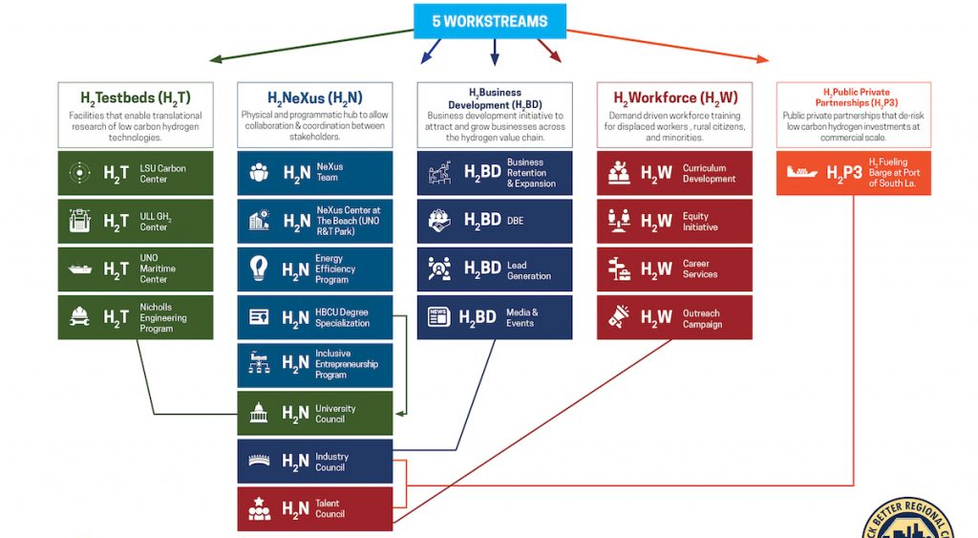
H₂theFuture Initiative
Notes:
Content + Gallery

Slide 7
LFE Overview
Notes:
Section Header

Slide 8











Expanding Louisiana’s Energy Legacy
ALL-OF-THE-ABOVE ENERGY STRATEGY
Renewable Fuels
Energy Storage
Carbon Capture
Hydrogen Fuel
Nuclear Energy
Battery Tech
& Manufacturing
Solar Power & Manufacturing
Wind Energy
Natural Gas
Oil & Gas Continuation
Notes:
Energy Initiatives

Slide 9
40
26K+
$10B
$60B+
PROJECTS
NEW JOBS PLANNED
IN FUNDING FROM IRA
IN CAPITAL INVESTMENT
Notes:
2018 to present, building upon legacy – incumbent and new

Slide 10
LOUISIANA FUTURE ENERGY
10
Louisiana has an opportunity to expand its energy leadership by developing the solutions required for the future of energy.
Notes:
The Big Idea

Slide 11
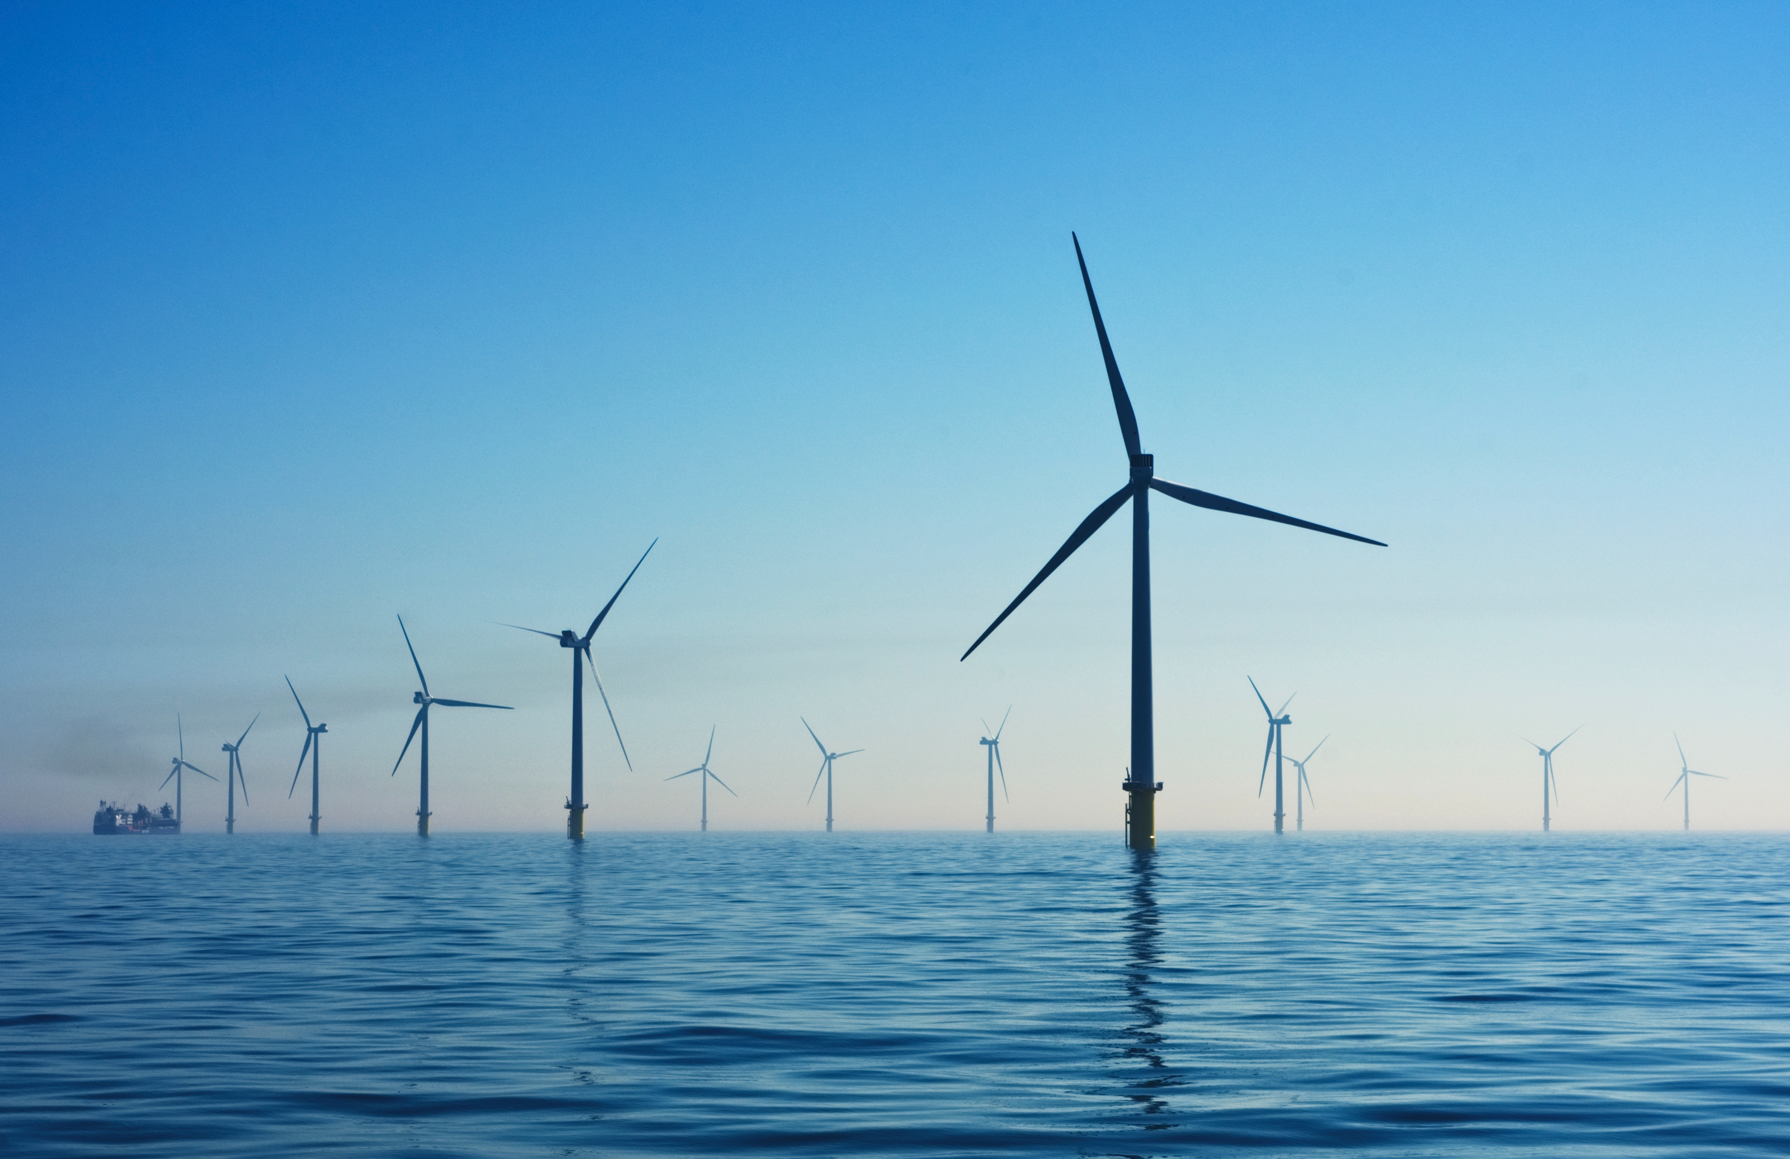
Thank you
Contact:
Cam Poole
Leo John Arnett
Energy & Innovation Manger
cpoole@gnoinc.org
Policy Advisor
ljarnett@gnoinc.org

Slide 12
Public Policy – Clean Hydrogen Task Force
45V Tax Credit
Procurement
Community Engagement
Competitive State Investments with 45V
Clear State Procurement Goals
Community Engagement in Energy Planning
Current Federal 45V rule's hourly temporal matching undercut emerging energy tech, since project delivery timelines for anticipated renewable resources are not projected to be completed by 2028
Competitive and targeted state investments will support nascent clean hydrogen industry, if Federal 45V final rules do not benefit Louisiana business
Stringency of final 45V rules will determine need and scope for augmented competitive state investments
Industrial Competitiveness has been demonstrated to increase with codified procurement goals, as industry demands renewable resources
Procurement targets for all-of-the-above energy resources strengthen the market case for emerging energy technologies
Resource planning across agencies, community leaders, industry, and economic development organizations will help ensure maximum local benefits are accrued
Local communities must be prioritized by businesses to include meaningful input in project advancement
Notes:
Energy Initiatives

