Slide 1
Legal & Regulatory Frameworks for Clean Hydrogen
Clean Hydrogen Task Force
December 3, 2024

Slide 2
Areas of Regulation
Production
  GHG Reporting – EPA: 40 CFR Part 98
Transport
  Pipeline Safety (Interstate – PHMSA & Intrastate – LDENR) 49 CFR Part 191, et seq., LAC 43:XIII Subparts 1 – 2.
  Rail Transport – PHMSA 49 CFR Part 174
  Maritime Transport – 49 CFR Part 176 (PHMSA), 33 CFR Parts 154 – 156 (USCG), 46 CFR Parts 38 & 150-154 (USCG).
  Trucking Distribution – USDOT 49 CFR Parts 171-178 & 180; USDOT-FMCSA 49 CFR Parts 356, 389 & 397
Storage
  Subsurface – Cavern Storage – LDENR LAC 43:XVII.3701, et seq.;
  Surface – OSHA – 29 CFR 1910 Subpart H

Slide 3
Hydrogen Production - Regulations
Green House Gas Reporting – 40 CFR Part 98 (EPA)
  Clean Hydrogen Production Target: 4.0 kgCo2e/kgH2
Steam Methane Reforming/Gasification
  Natural Gas Production – La. R.S. 30:1, et seq. (DENR)
  Carbon Sequestration – La. R.S. 30:1101, et seq. and LAC 43:XVII.3601, et seq.(DENR)
Electrolysis
  Water resource management – La. R.S. 38:3092, et seq.; La. R.S. 30:961, et seq.(DENR)

Slide 4
Hydrogen Production - Regulations
Depending on specifics additional regulations may be implicated:
  Spill Prevention & Control (LDEQ/EPA)40 CFR Part 112
    Oil of any kind and in any form and certain listed substances in liquid form meeting minimum storage capacities
  Louisiana Pollution Discharge Elimination System – Water Quality Requirements - LAC 33:Chapter IX (LDEQ/EPA)- permit required for any point source discharge of a pollutant into waters of the state
  Air pollution requirements for HAPs/TAPs and Criteria Pollutants (LDEQ/EPA) 40 CFR 60, 61, & 63

Slide 5
Transport - Pipelines
DENR – Intrastate Pipeline Safety (LAC 43:XIII.Subparts 1 – 4) Louisiana rules adopt federal “gas” pipeline safety regulations, which defines gas as natural gas, flammable gas, or gas which is toxic or corrosive
PHMSA – Interstate Pipeline Safety (49 CFR Part 191 – Reporting Requirements, Part 192 – Minimum Safety Standards, and Part 199 – Drug and Alcohol Testing)

Slide 6
Transport - Pipelines
Because same safety regulations apply to both hydrogen and natural gas, the blending of hydrogen with natural gas should not impact applicability of existing safety regulations
  However, an operator should assess if the introduction of hydrogen changes the risks to pipeline, thereby necessitating a change to the operator’s integrity management program.

Slide 7
Transport - Pipelines
If hydrogen is derived from natural gas (or other hydrocarbons) then Pipeline Operator would be subject to Natural Resources & Energy Act (La. R.S. 30:501, et seq., and applicable rules LAC 43:XI.Subpart 1) - DENR
  Covers intrastate gas pipelines and defines “gas” as “any gas derived from or composed of hydrocarbons.”
  Certificates of Transportation, approvals of construction, connections, and abandonments of lines
  R.S. 30:554 – “All such persons receiving a certificate of transportation from the commissioner shall possess the right of expropriation with authority to expropriate private property under the general state expropriation laws,…”
  Based on definition of “gas,” this Act would not apply to hydrogen produced through electrolysis.
No FERC or equivalent federal regulation for necessity determinations or construction approvals

Slide 8
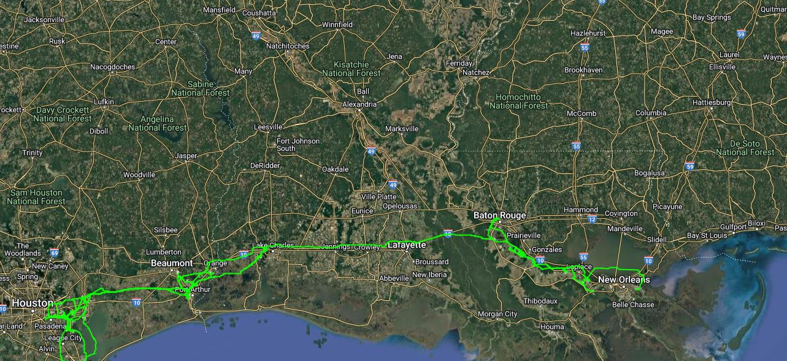
Existing Hydrogen Pipelines

Slide 9
Transport – Rail & Truck Traffic
Rail – PHMSA 49 CFR Part 174 – Transportation of Hazardous materials via rail
Trucking Distribution – USDOT storage and transport of hazardous materials (49 CFR Parts 171-178 and 180); USDOT/FMCSA – licensing and testing standards (49 CFR Parts 356,389, and 397)
Trucking with Hydrogen as fuel – Weight limits on interstates and certain highways (23 CFR Part 658, Appendix C)

Slide 10
Transport – Maritime
PHMSA – Hazardous materials transport by vessel (49 CFR Part 176) for explosive substances
Pollution Prevention – USCG (33 CFR Parts 154 – 156)facilities transferring hazardous materials in bulk, hazardous material pollution prevention for vessels, and hazardous materials transfer operations
Shipping of Hydrogen – USCG (46 CFR Parts 38, and 150 – 154) transportation of liquefied or compressed flammable gases by vessels, cargo compatibility, barges carrying bulk liquid hazardous material cargoes, ships carrying bulk compressed gas hazardous materials, and self-propelled vessels carrying bulk liquefied gases

Slide 11
Storage - Subsurface
The 1974 Safe Drinking Water Act (SDWA) established the national Underground Injection Control (UIC) Program under the EPA and charged them to:
  Establish Technical Regulations for UIC Program
  Define the Underground Source of Drinking Water (USDW)
  Establish Injection Well Classifications
Solution-mined Salt Dome Cavern Storage
  Two-step process
    Step 1: Solution Mine the Cavern or Cavity to be used for storage – Class III Injection Well
    Step 2: Permit for Injection/Storage of Hydrogen – Class V Injection Well

Slide 12
Hydrogen Storage in Salt Caverns
Why cavern storage?
  Places the highly flammable gas in an oxygen-free zone to prevent accidental ignition.
  Access to large storage volumes with extended storage periods.
  Minimizes surface footprint.
  Minimum leakage due to tightness of the salt rock
  Low operational cost and have a high recovery efficiency when compared to other underground storage options (depleted oil & gas reservoirs, aquifers, etc.)

Slide 13
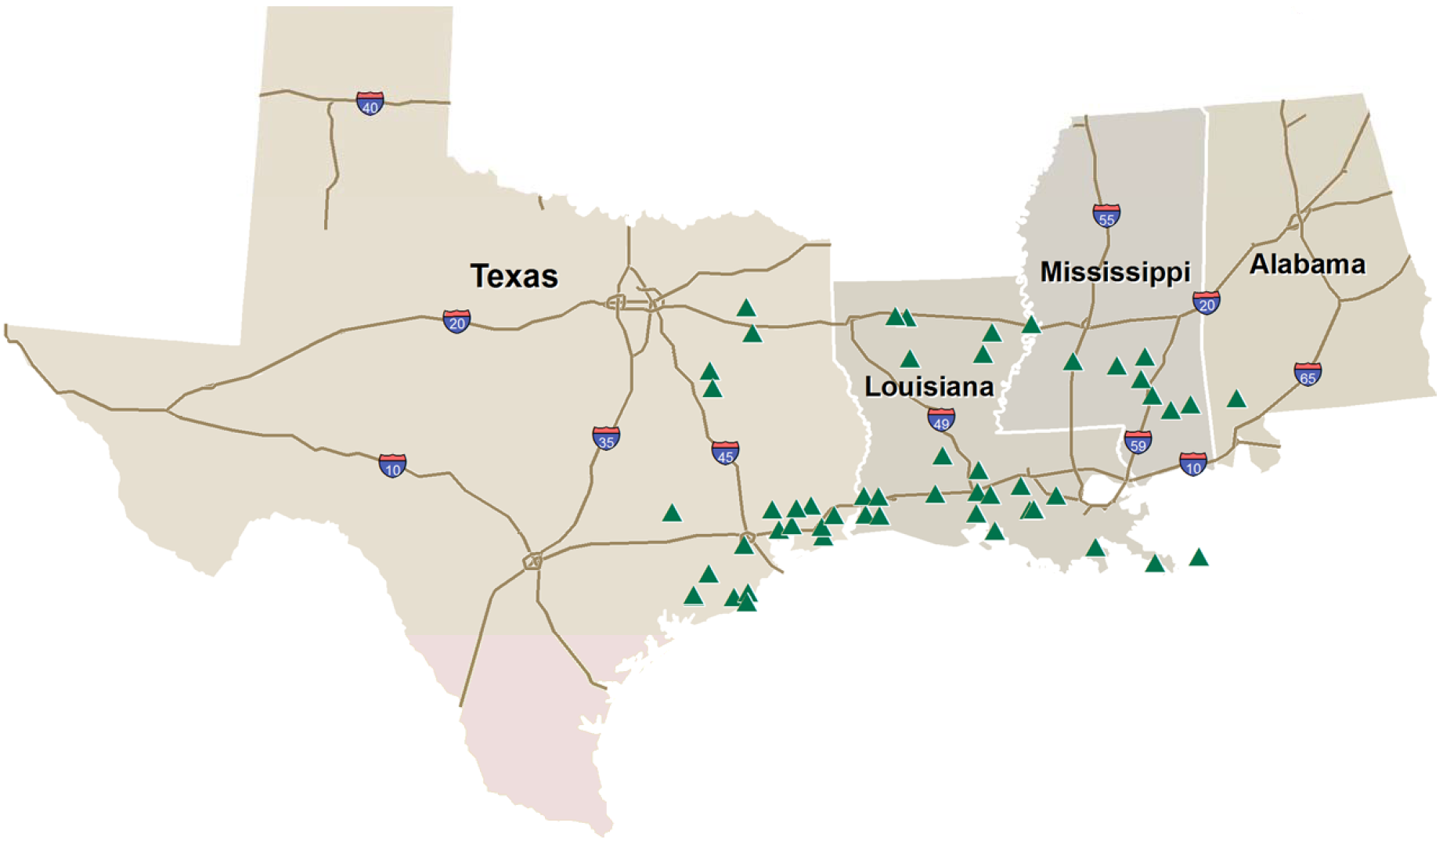
Gulf Coast Salt Cavern Facilities

Slide 14
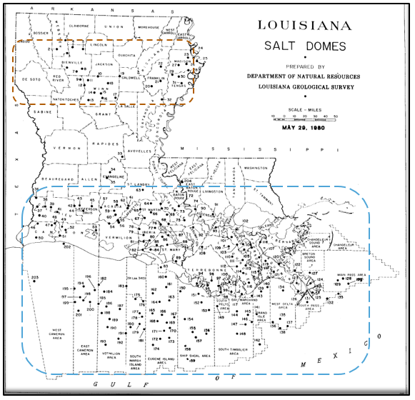
Louisiana Salt Domes
In Louisiana (including Federal Offshore), there are 200+ known or identified salt domes
Louisiana has two salt basins, the North Louisiana Salt Basin and the Gulf Coast Salt Basin.
Louisiana currently has 20 “active” salt domes; active meaning there are salt caverns with active permits.
419 individual entries into caverns with active permits in Louisiana.

Slide 15
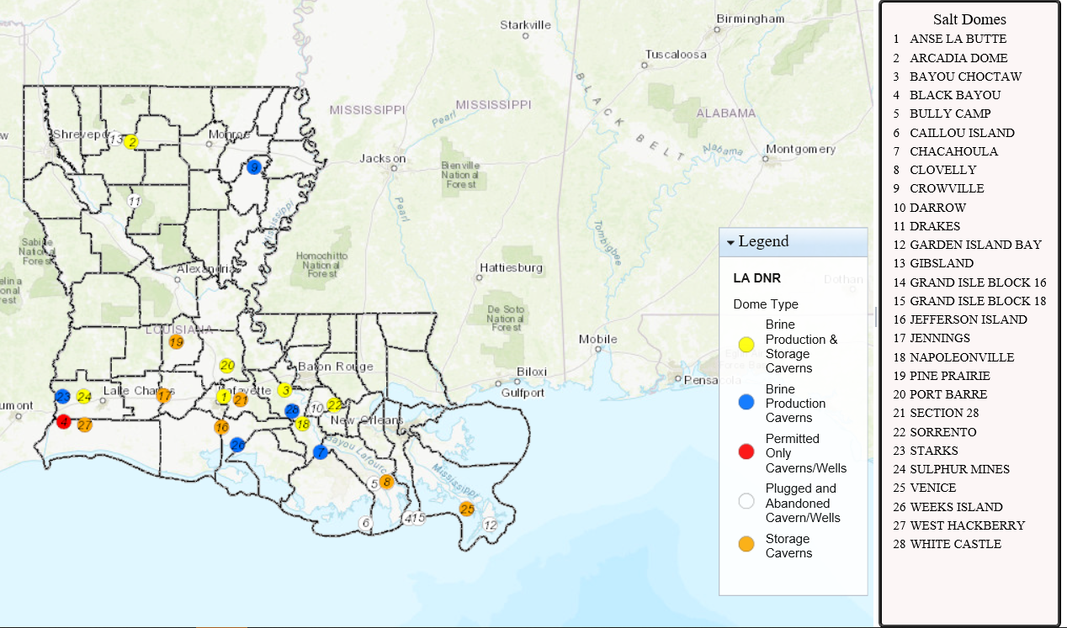
Storage – Historically Active Louisiana Salt Caverns

Slide 16
History of Hydrogen Storage in Salt Caverns
Salt caverns have been used for hydrogen storage in Europe since the 1970’s.
    Teeside, UK – 1970’s
    Kiel, Germany – 1971
The only existing hydrogen storage caverns in the US are currently located in Texas.
    Clemens Dome (ConocoPhillips) - 1986
    Moss Bluff Dome (Praxair) – 2007
    Spindletop (Air Liquide) – 2016

Slide 17
History of Hydrogen Storage in Salt Caverns
The EPA does not currently have a classification specific to hydrogen storage in salt caverns
    Louisiana will permit them as Class V
    The existing hydrogen storage caverns in Texas are permitted as Class II
    Rumblings of a new EPA classification in the future (Class VII?)

Slide 18
Class V Storage Caverns
Notable differences between Class II-Hydrocarbon Storage Well caverns and Class V Gas Storage Caverns
  Class V permits may be permitted for up to 10 years and then will need to be re-permitted
  Well construction (i.e. casing types, cement types, and wellhead components) compatibility with the stored product(s)
    The first casing cemented into the salt must have connection seals approved by the commissioner
    Any cemented casing in contact with hydrogen must have welded connections with verified integrity
    Special tubulars or cement types may be required depending on the hydrogen concentrations being stored
    Wellhead seals must be compatible with the stored material
    More frequent testing requirements for certain stored products

Slide 19
Questions?

