Slide 1
Louisiana
Public Service Commission
Brandon M. Frey
Executive Secretary

Slide 2
Customer Centered Options
General Order dated August 1, 2024 (R-35462); In re: Rulemaking to Research and Evaluate Customer-Centered Options for all Electric Customer Classes as well as Other Regulatory Environments
Attachment 1 – Annual Reporting Obligations for Electric Utilities
Attachment 2 – Periodic Reporting of Utility Outside Attorneys and Consultant Expenses
Attachment 3 – Renewable Energy Credits Value
Attachment 4 – Sleeved Power Purchase Agreements

Slide 3
What is a sleeved power purchase agreement?
A Sleeved PPA is a PPA for renewable generation negotiated between an end-use customer of a utility and a renewable developer or owner, and the utility becomes involved to facilitate the delivery of the energy and the payment streams. The costs are borne by the end-use customer and the benefits are enjoyed by the end use customer, not all customers.

Slide 4
Sleeved power purchase agreements
Before the Rule: While customers were free to enter into market transactions in the MISO market (i.e., virtual PPAs) in order to obtain the attributes of renewable generation (i.e. RECs), there was no ability for an industrial customer to directly contract with a renewable resource developer to obtain the output of a renewable generator. Industrial customers claimed that this contractual relationship is essential to their environmental claims in certain markets, particularly European markets.

Slide 5
Sleeved power purchase agreements
After the Rule:
  The Rule requires that all Sleeved PPAs must be approved by the Commission. If the PPA includes adequate non-participant protections in the PPA (i.e., participant posts collateral, utility has right to cancel PPA, or states no obligations of utility), then PPA would be signed by utility and Commission’s approval would occur within 60 days. If the PPA does not include adequate customer protections, then full certification proceeding is required under 1983 General Order and Commission should evaluate potential harm to non-participants.
  Limitations
    Sleeved PPAs in total cannot exceed 5% of utility’s peak demand (~ 500 MW for ELL)
    No one customer Sleeved PPA can exceed 1% of utility’s peak demand or be more than 150% of the customer’s peak demand.
  Eligibility
    All non-residential customers with load of 5 MW or more (can aggregate)
    First come, first served, but to reserve capacity, participating customer must have completed negotiations to a point where it has identified a counterparty, a resource, and a price.

Slide 6
LPSC nuclear orderS
General Order dated November 2, 2006
  Docket No. R-26172 Sub Docket B– Possible amendments to the Market Based Mechanism General Order dated February 16, 2004, to provide exceptions to the use of a request for proposal competitive solicitation process in certain circumstances involving solid fuel and nuclear resources.
General Order dated May 18, 2007
  Docket No. R-29712 Investigation into the ratemaking and generation planning implications of nuclear construction in Louisiana.

Slide 7
INTEGRATED RESOURCE PLANS
General Order dated August 28, 2024 (R-36262)(Corrected)
Requires the development of long-term resource plans, which include both supply and demand-side resources, and considers transmission needs, in order to satisfy the utility’s load requirements.
Used by utilities to create internal business plans.

Slide 8
Nuclear in IRPs
The Commission’s RSP rules do not mandate specific outcomes, nor that certain decisions be made. However, the rules do encourage a collaborative working process with stakeholders.
At the Commission’s February Business and Executive Session, Commissioner Skrmetta stated on the record:
  “I want to make sure that … we are at least discussing the options for nuclear in some component as part of our IRP discussion….We should be looking down the road on this at least five to six years so that becomes a true analysis

Slide 9
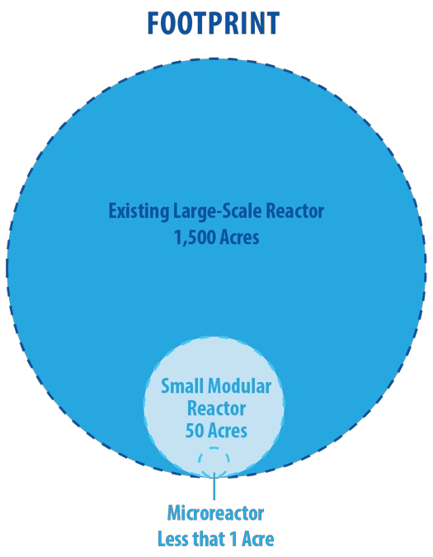

Existing nuclear vs. new nuclear
Cite: Idaho National Lab: Perspectives on Deployment of Advanced Nuclear Energy

Slide 10
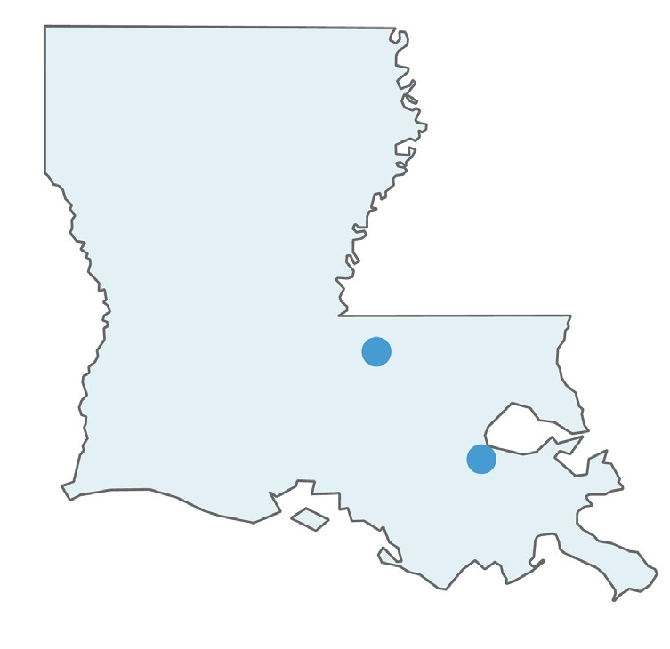

Existing Nuclear in Louisiana
2 nuclear plants in Louisiana, both owned and operated by Entergy, Louisiana.
  River Bend Nuclear Station
  Waterford 3 Steam Electric Station
Both received renewed operating licenses from the Nuclear Regulatory Commission (NRC) that extend to 2044 (Waterford) and 2045 (River Bend).

Slide 11
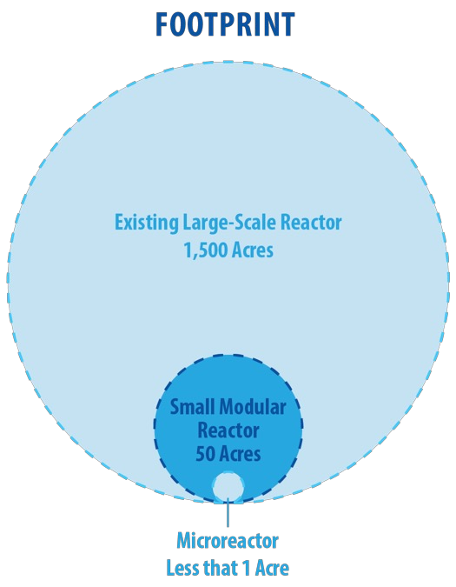
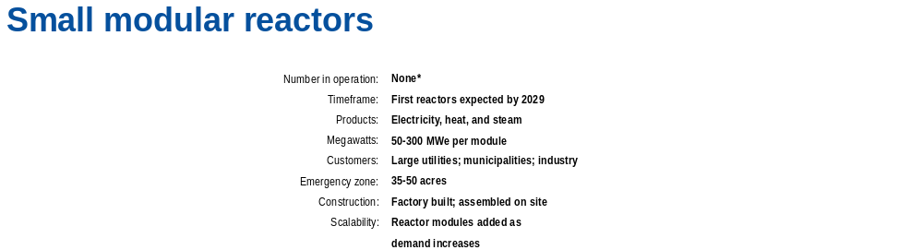
Existing nuclear vs. new nuclear
Cite: Idaho National Lab: Perspectives on Deployment of Advanced Nuclear Energy

Slide 12
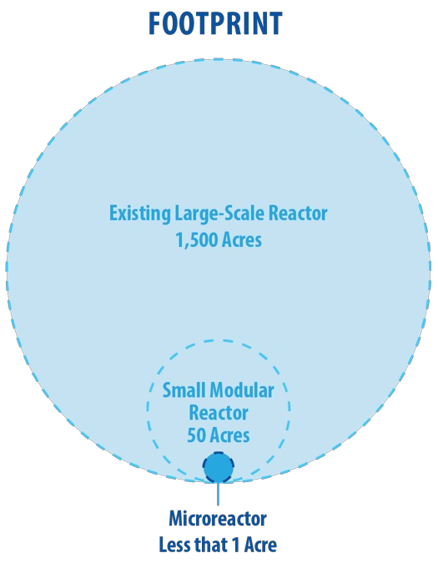

Existing nuclear vs. new nuclear
Cite: Idaho National Lab: Perspectives on Deployment of Advanced Nuclear Energy

Slide 13
Louisiana Advanced Nuclear Competitive Edge
“LANCE” Framework
Report prepared by Idaho National Lab’s Frontiers Initiative
LPSC led the development of this framework to study and track advanced nuclear power technology.
Launch held June 17-18 in New Orleans.
  Structured discussion with key industry stakeholders and initiated the development of the strategic framework for leadership in advanced nuclear energy-driven economic development, including identification of key differentiators, priority markets, key partnerships, gaps and potential roadblocks, priority next steps, and capacity development needed to execute.

Slide 14
The framework’s strategic pillars
GENERATION - Examine opportunities where Louisiana can deploy new advanced nuclear generation resources to address needs and solve emerging concerns. Seek to expand the generation of clean dispatchable power to address the energy transition.
SUPPLY CHAIN - Identify supply chain opportunities for existing business and industry seeking to support the deployment of advanced nuclear power resources, which may require a breadth of component manufacturing and professional services to deploy and operate advanced nuclear energy systems. Seek supply chain considerations that impact state, national, and global markets. This could include, but is not limited to construction, services, and manufacturing.
VALUE CHAIN - Examine how Louisiana can leverage nuclear energy (combined heat and power) to drive low-emission, high-value industry development. Explore how the state can assist in leveraging value propositions that enable an advanced nuclear energy-driven economic opportunity for Louisiana.

Slide 15
Next steps for lance
Report to be presented to Commissioners at January Business and Executive Session.
Will continue to monitor the development of advanced nuclear power technology in Docket No. X-36987.

